Slide 1
WordPress Upgrades: Ready, Set, Go!
Experience From Over a Million WordPress Upgrades
Presented by Dustin Meza @ WordCamp Scranton July 18th, 2015

Slide 2
WordPress Upgrades: Ready, Set, Go!
@DustinMeza on Twitter
Follow Me for the Link to the Slides

Slide 3
Dustin Meza
Director of Customer Experience Operations
Senior Manager, Cloud Operations
BA Business Management

Slide 4
Why Should You Listen To Me?
Own the Entire WordPress Upgrade Process @ WP Engine
Upgrading WordPress since version 3.5
Handled every upgrade deferral request for 2+ years
We’ve performed over 1 million upgrades

Slide 5
Disclaimer
My advice is based on my experience and what I have seen work for customers
Every site is unique
There’s most likely an exception to every rule
You will need to dedicate time, but it’s well worth it

Slide 6
What People are Saying
There are so many updates, I can’t keep up
I always stay 1 version behind so they can work out the bugs
I don’t need the upgrade because my site just works
How could I ever know what an update will do to my site?
WordPress upgrades always break my sites

Slide 7
The Struggle is Real

Slide 8
What is an Upgrade?
Feature/Functional Upgrade
An upgrade that adds or removes features and functionality
A major (x.0) or minor (4.x) version increase
Maintenance Upgrade
An upgrade that that fixes bugs, it does not add or remove features or functionality
A point/dot release (4.2.x)
Security Upgrade
An upgrade that closes security vulnerabilities, it does not add or remove features or functionality, unless the functionality itself was vulnerable
A point/dot release (4.2.x)

Slide 9
What is an Upgrade?
Core Contributers
The Community
Beta(n)
Bug Reports
Release Candidate
Beta(n)

Slide 10
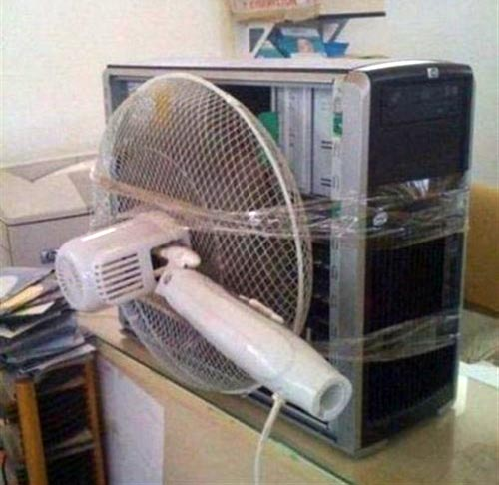
Maintenance is a Must

Slide 11
A Well Oiled Machine
More Horse Power (Speed)
Tuned Perfectly (Efficient)
All the Options (feature rich)
Fancy Car Alarm (Security)

Slide 12
Step 1: Get to Know Your Site
Catalog your Plugins
List each plugin
Rank them (High, Medium, Low) in respect to the criticality to your site
Place a few sentences of notes on front end functionality
Provide exact instructions for how to reproduce the functionality

Slide 13
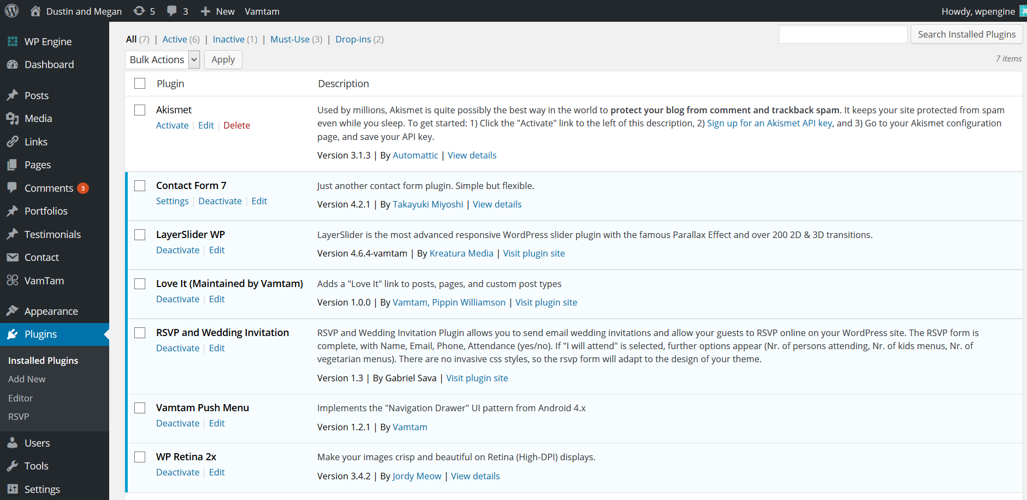

Slide 14
Step 1: Get to Know Your Site
Catalog Theme & Custom Functionality
List out the functions
Rank them (High, Medium, Low) in respect to the criticality to your site
Place a few sentences of notes on front end functionality
Provide exact instructions for how to reproduce the functionality

Slide 15
Step 2: Get to Know Your Devs
For the High critical plugins/themes
Contact the Dev/Support Teams
Let them know the specific functionality you are using
Open a dialogue with them on that functionality
Is that functionality a core part of the plugin or more of an add-on?
What’s the future of that functionality look like for them?
What kind of development cycles do they have, how do they get ready for new versions of WordPress?
Find at least one alternative to each plugin

Slide 16
Step 3: Get to Know the Future
Subscribe to Releases on the WordPress.org blog
Evaluate each Beta release post
Contact devs to understand their thoughts on if the plugin is impacted
If so, find out when they believe they will be compatible
Identify if any custom functionality may be impacted
If so, it might be a good idea to test the beta release
Now you have an idea of what is coming and how the site may be impacted

Slide 17
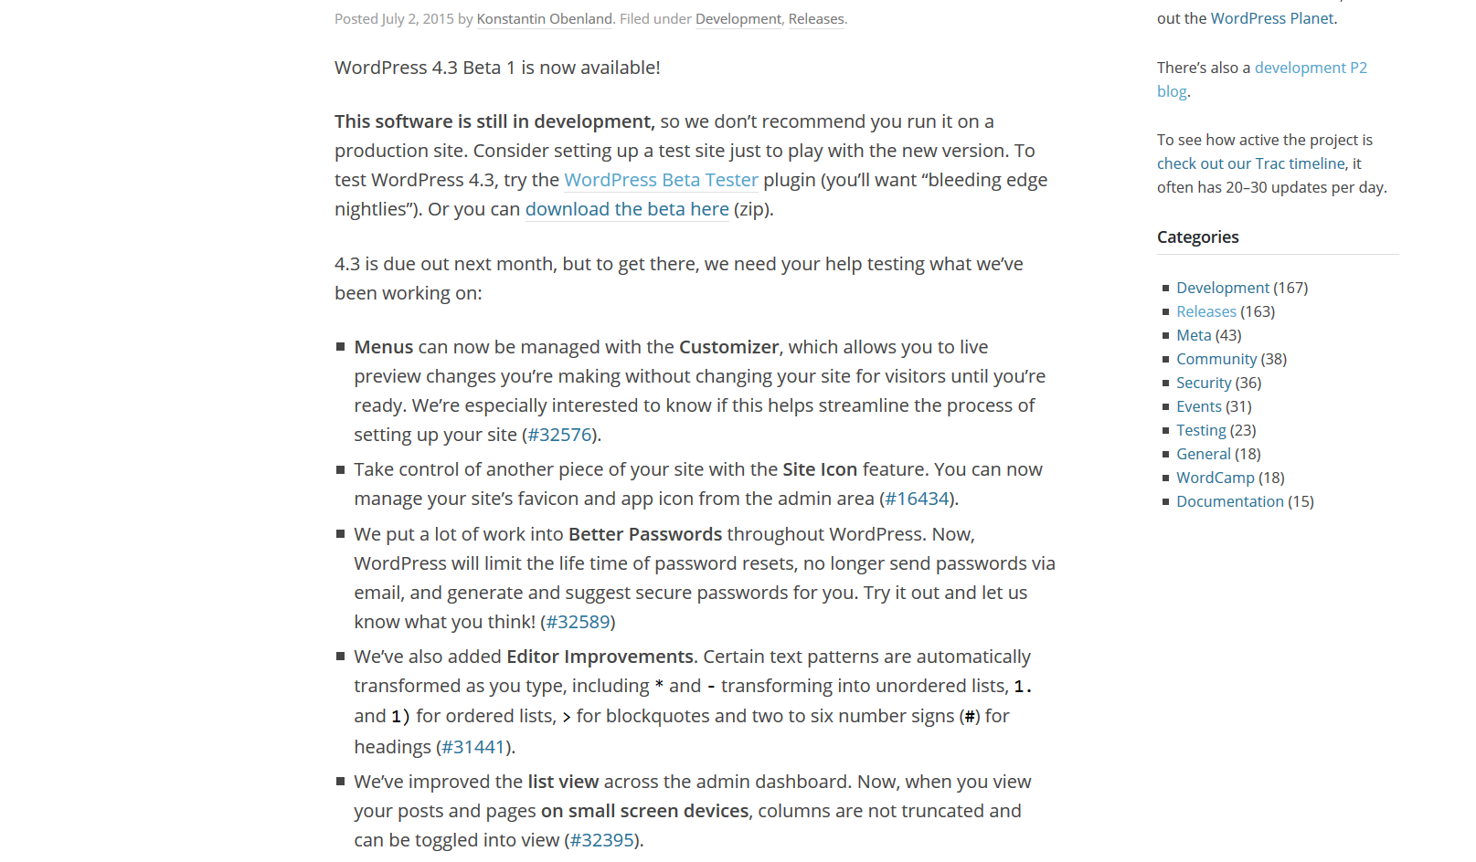

Slide 18
Step 3: Get to Know the Future
Subscribe to Releases on the WordPress.org blog
When a Release Candidate Post is made
Contact devs to understand if they believe the plugin is compatible, if not, when do they plan on releasing an update
Create a staging site
Install the WordPress Beta Tester plugin and follow the steps to upgrade to the latest release

Slide 19
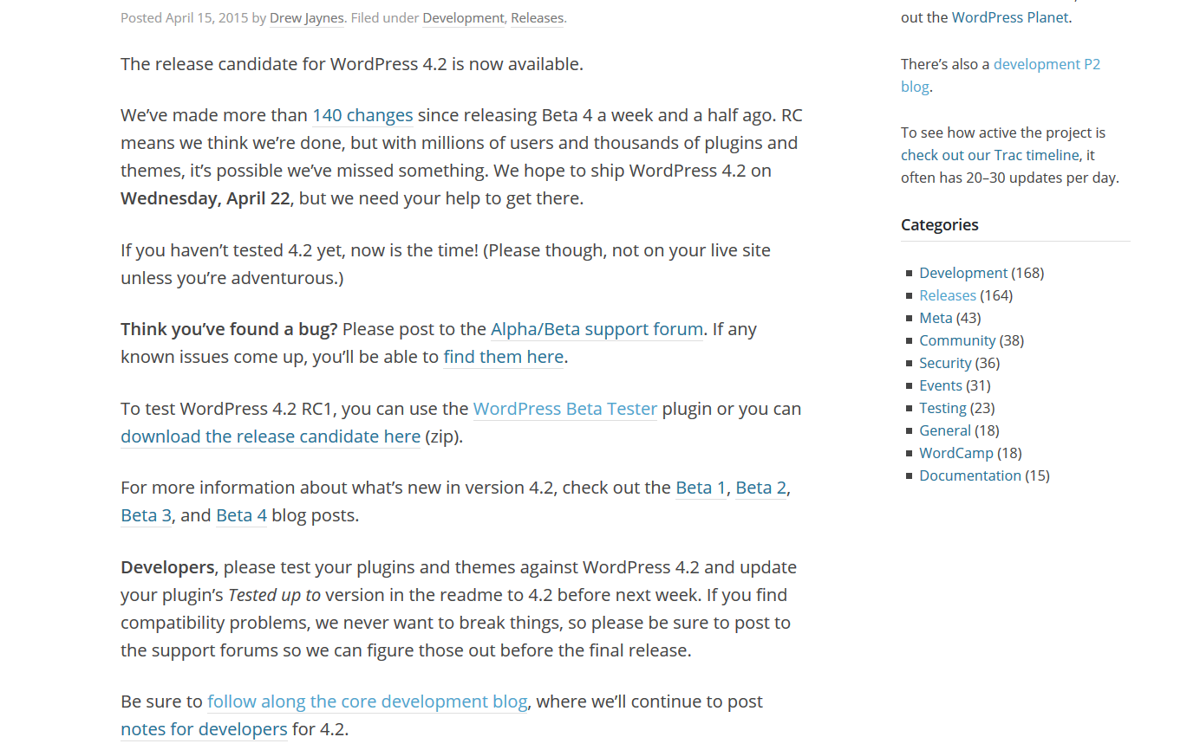

Slide 20
Step 3: Get to Know the Future
It’s time to test
On your staging site, update all plugins and themes (you shouldn’t have any to update ☺)
Execute the steps to recreate the functionality you documented earlier
Document each result and specifics about any failures
Execute any backend functions that are unique to your site and document failures

Slide 21
Step 4: It’s Go Time
How are the results?
If there are no issues, skip to step 5
If there are issues, let’s dig in
If the issue is with a Medium or Low criticality function
You have some options

Slide 22
Step 4: It’s Go Time
Medium or Low?
Do nothing, because the functionality isn’t critical
Contact the plugin dev, find out what the timeframe is for an update
If quick, wait to upgrade, if longer, you may decide to upgrade without it
Replace the functionality
You could build something custom to replace it
You could find an alternate plugin to use instead

Slide 23
Step 4: It’s Go Time
High?
Contact the plugin dev, find out what the timeframe is for an update
This will completely determine when you can upgrade
Replace the functionality
You could build something custom to replace it
You could find an alternate plugin to use instead

Slide 24
Step 5: Worry Free Upgrade
Once all issues have been resolved
You will have a much better understanding of your site
You won’t fear the upgrade button
You will be ready for any maintenance or security upgrades that are released, no testing needed
You will have a game plan for the next functional upgrade

Slide 25
Step 5: Worry Free Upgrade
Preparing for Next Time
If you documented everything you did, this process will take half the time in the future
If you manage lots of sites, the testing plans and communication to devs gets easier
Ensure you plan your time accordingly over the next quarter
Following this plan takes time, but it also means a lot less surprises

Slide 26
WordPress Upgrades: Ready, Set, Go!
Experience From Over a Million WordPress Upgrades
Presented by Dustin Meza @ WordCamp Scranton July 18th, 2015

